Slide 1
Love

Slide 2
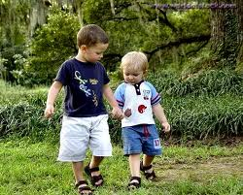
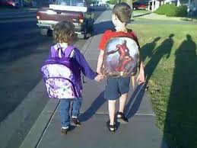
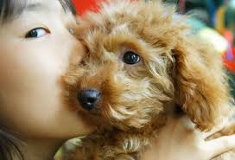
Who do you love?
What do you love?

Slide 3
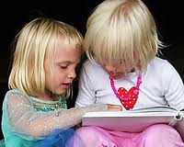
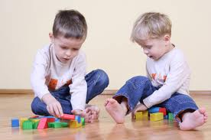
How do you show your love?

Slide 4
Why do we love?
Just as blood nourishes the heart so love nourishes the spirit
A life devoid of love is a flower blooming in the wilderness, With nobody to enjoy its fragrance. (Kabirji, Gauri Rag)
To love and to be loved is the greatest happiness.

Slide 5
Why do we love?
Let us not love with words or tongue but with actions and in truth.-- 1 John 3:18
God loves the kind: Chapter 60, Verse 8
Love your neighbour like yourself:
Leviticus 19:18 in the Torah

Slide 6
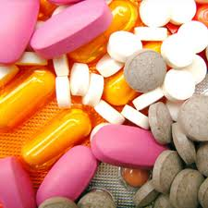
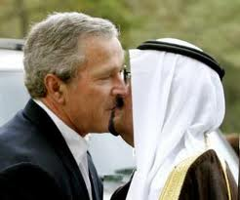
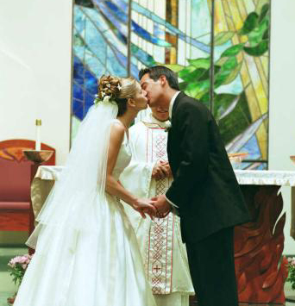
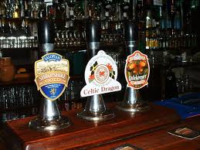
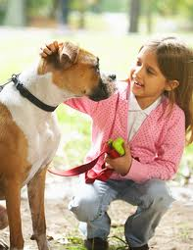
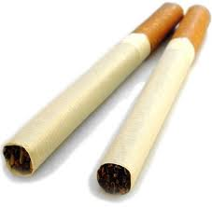
Loving people. Loving things.
Is it ever wrong to love people?
Is the love of things e.g. cigarettes always good?

Slide 7
Good love is when…………………….

